Slide 1

Rubyizing the Devs and Ops of an Enterprise
Yashasree Barve

Slide 2
About me
Technologist @ TCS since last 13 years
An Agile Ruby developer since 2007
&
I'm lovin' it

Slide 3

Back in 2007
Who is this Ruby?

Slide 4

A Rewarding Journey
2011
I Love Ruby
2007
Who is this Ruby?

Slide 5
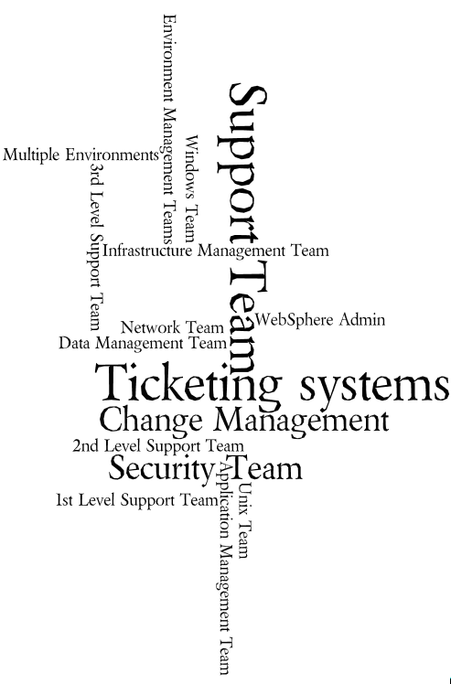
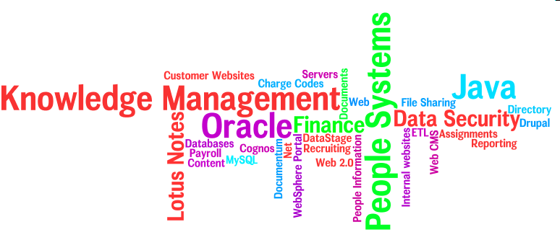
An Enterprise
Images created using wordle.net

Slide 6
Agile Enters the Enterprise

Slide 7


Slide 8
Let us try Ruby and Rails!

Slide 9

But This is An Enterprise…
Heterogeneity
Performance
Availability
Complexity
Security
Scalability
Reliability

Slide 10
How to eat an Elephant?
One bite at a time!

Slide 11
THE RAILS WAY

Slide 12
Believe it or not,
most big company security break-ins
involve your employees!

Slide 13




Security Plug in
Apache Passenger
Authenticate
Security
Plug in
Rails
App
Login
Single Sign On Server
Authorize
Enterprise Directory Server

Slide 14
Microsoft ADS
Domino LDAP
IBM ITDS
Support ALL of those!

Slide 15
Directory Server Plug in
Enterprise Directory Server
Apache Passenger
LDAP
Plug in
Rails
App
> person = MyLdap::Person.find_name 'John Doe'
> person.first_name #=> 'John'
> person.last_name #=> 'Doe'
> person.is_contractor? #=> true
> person.is_in_group?('some_admins') #=> true
> person.groups #=> ['some_admins', 'that_user']
> group = MyLdap::Group.find_by_name 'some_admins'
> group.contains? person> #=> true
> Other ways to find a person:
> MyLdap::Person.find_by_distinguished_name
> MyLdap::Person.find_by_sso_name

Slide 16
every Page you See
every Click you Make

Slide 17
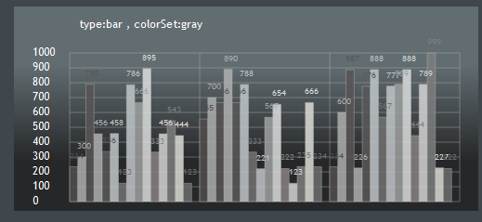
Usage Tracking
Apache Passenger
Enterprise Usage Tracking
External Server
Tracking
Plug in
Rails
App
HTTP
enable_page_tracking to track who visited which page
link_to to send info about clicked link
Set defaults in environment.rb
Define app specific parameters in environment config
Rake task to include relevant files in the application

Slide 18
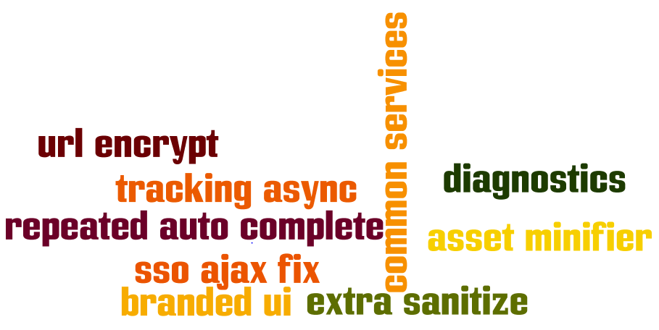
Plug ins that DRYed us

Slide 19
Hosting Internally
C:\my_app\trunk>gem install –source
http://mygemserver:8808/ distribute
Gem Server
C:\my_app\trunk>ruby script/plugin
install my_security –source
http://svn....com/ruby/plugins/my_security/trunk
Enterprise
Subversion Server

Slide 20
    Rails
    Up and Running
SOURCE: Source

Slide 21
Create a Brand New Rails app that
    gets committed in SCM
    configured on CI
    branding, security, ldap, and so on installed
    ready to be deployed with configured Capfile
    defaults to rspec, mocha, cucumber

Slide 22
Way We Work
Keep it
Simple.
Automated
Tests,
A part of life.
Continuously
Integrate,
Release
Often.

Slide 23
Vibrant Rubyists Group
Team up
Share
Excel

Slide 24
Oops!
But what about the
Ops

Slide 25
The BIG Task of Deployment
C:\my_app\trunk>capd deploy:migrations
triggering start callbacks for `deploy:migrations'
Select Stage:
1. production
2. integration
3. devutility
4. qa
Please select:
> capd apache:configure
> capd apache:passenger:configure
> capd apache:restart
> capd install
> capd uninstall
> capd deploy:bundle_gems
> capd deploy:minify_and_upload_assets
> capd deploy:minify_erbs
> capd google:configure
> capd ldap:configure
> capd database:configure
> capd hoptoad:notify
    Powered by Capistrano and Passenger

Slide 26
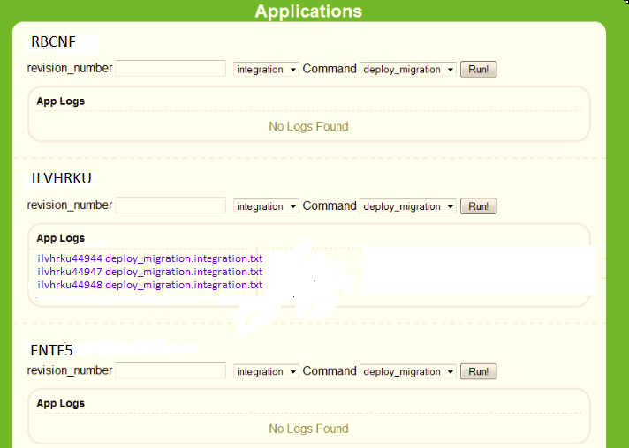
Towards One Click deployment
    Inspired by Heroku

Slide 27
Busting those Tickets!
Legacy Enterprise Apps
Apache Passenger
Admin Rails
App

Slide 28
More Transparency
Splunk
Hoptoad

Slide 29
Chef at work
Infrastructure as a code
and
The code is Ruby

Slide 30
Envisioning the Provisioning
Monitor the App Performance
Spin a virtual server to scale horizontally

Slide 31
Dev Ops

Slide 32
This presentation would not have been possible without
My fellow Rubyists
Amit Kumar
Thomas Newton
Patrick Shaughnessy
&
My creative designer buddy
Mayura Sawant
Thanks mates!

Slide 33
Thank you all for being patient and hearing me out.
Hope this helps you!
Any questions?

